Slide 1


Slide 2
DIGITAL PHORTFOLIO......
STUDENT NAME : P.F.Nidha suman
REGISTER NO AND NM ID :31224U18032 and F2818963E0296F3AA844CB2528486599
DEPARTMENT: B.sc computer science
COLLEGE/UNIVERSITY: ISLAMIAH WOMEN’S ARTS AND SCIENCE COLLEGE/THIRUVALLUVAR UNIVERSITY

Slide 3
Project TITTLE....
STUDENT PORTFOLIO...
ABOUT ME 😇......

Slide 4
AGENDA....
PROBLEM STATEMENT
PROJECT OVERVIEW
END USERS
TOOLS AND TECHNOLOGY
PORTFOLIO DESIGN AND LAYOUT
FEATURES AND FUNCTIONALITY
RESULTS AND SCREENSHOT
CONCLUSION

Slide 5
PROBLEM STATEMENT
A student digital portfolio project statement should clearly introduce you, the purpose of the portfolio, and the specific projects it showcases, including a detailed description of your individual contributions, challenges faced, solutions implemented, and key learnings and reflections on the experience.

Slide 6
Project overview
A student digital portfolio is a curated, online collection of a student's work, projects, and reflections that showcases their learning journey, skills, and achievements over time.
These e-portfolios serve as a versatile tool for students to document their growth, gain confidence, and present a comprehensive view of their capabilities to teachers, peers, and potential colleges or employers.
They typically include multimedia "artifacts" like essays, artwork, and videos, accompanied by written reflections from the student, which fosters self-awareness and metacognitive skills.

Slide 7
WHO ARE THE USERS
STUDENTS (ACADEMIC PROJECTD, RESUMES)
JOB SEEKERS (TO SHARE WITH RECRUITERS)
FREELANCERS (TO SHOW CLIENTS)
PROFESSIONALS (TO HIGHLIGHT EXPERIENCE AND ACHIEVEMENTS).

Slide 8
TOOLS AND TECHNIQUES
TOOLS
Text Editor/IDE:
VS Code: A popular and versatile code editor with extensions for web development.
Sublime Text: A lightweight and highly customizable text editor.
Atom: A hackable text editor built by GitHub.
Web Browser: For testing and viewing the portfolio (e.g., Chrome, Firefox, Edge).
Version Control:
Git: Essential for tracking changes and collaborating on projects.
GitHub/GitLab/Bitbucket: Platforms for hosting Git repositories and showcasing code.
Image Editing Software: For preparing and optimizing images (e.g., GIMP, Photoshop, Canva).

Slide 9
TECHNIQUES
HTML
CSS
JAVASCRIPT

Slide 10
HTML
Semantic HTML5: Utilize elements like <header>, <nav>, <main>, <section>, <article>, <footer> for clear document structure and accessibility.
Divisions and Spans: Employ <div> and <span> for grouping content and applying specific styling.
Forms: Create contact forms or project submission forms using <form> elements with various input types.

Slide 11
CSS
Styling: Applying visual design elements such as colors, fonts, layout (e.g., flexbox, grid), spacing, and responsiveness for different screen sizes.
Animations and Transitions: Enhancing user experience with subtle animations or transitions on hover effects, navigation menus, or project displays.
External Stylesheets: Linking a separate .css file to the HTML for cleaner code and easier maintenance

Slide 12
Javascript
JavaScript:
Interactivity: Adding dynamic features like image carousels, filterable project galleries, form validation, or interactive navigation menus.
DOM Manipulation: Modifying HTML content and CSS styles dynamically based on user interactions or data.
API Integration (Optional): Fetching data from external APIs (e.g., for a weather app project, or displaying GitHub repository details).

Slide 13
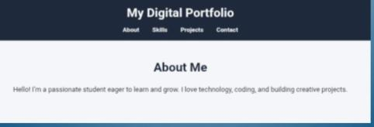
Portfolio design and lAyout
ABOUT ME

Slide 14
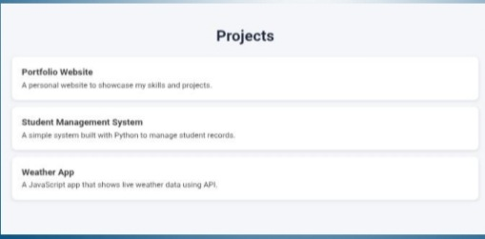
Project

Slide 15
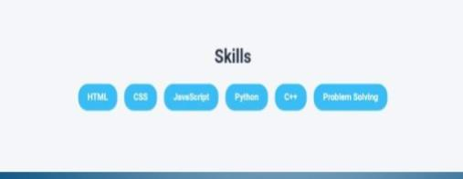
Skills

Slide 16
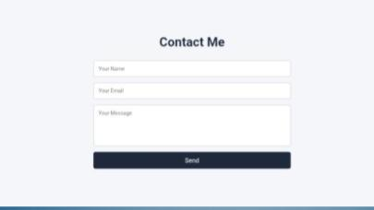
Contact

Slide 17
Features and functionality
Student digital portfolios should allow for the incorporation of multimedia elements like text, images, audio, and video, and should feature a clean, navigable design with an "About Me" section and a skills overview.
Functionally, they should enable easy uploading, editing, and organization of work, provide tools for student reflection, and offer secure sharing options for teachers, peers, families, and potential employers.
Key features include the ability to showcase a range of work samples to demonstrate skills, project descriptions explaining challenges and solutions, and testimonials to build credibility.

Slide 18
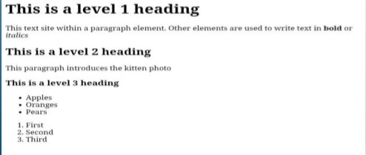
Results and screenshot
HTML PAGE

Slide 19
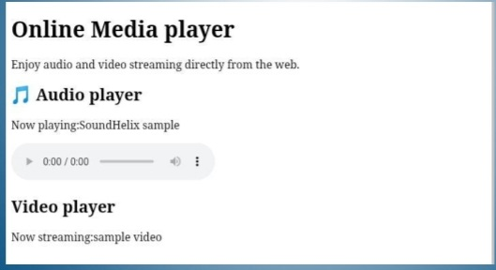
Audio Player

Slide 20
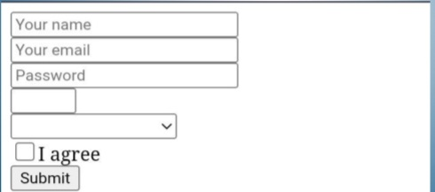
Portfolio form

Slide 21
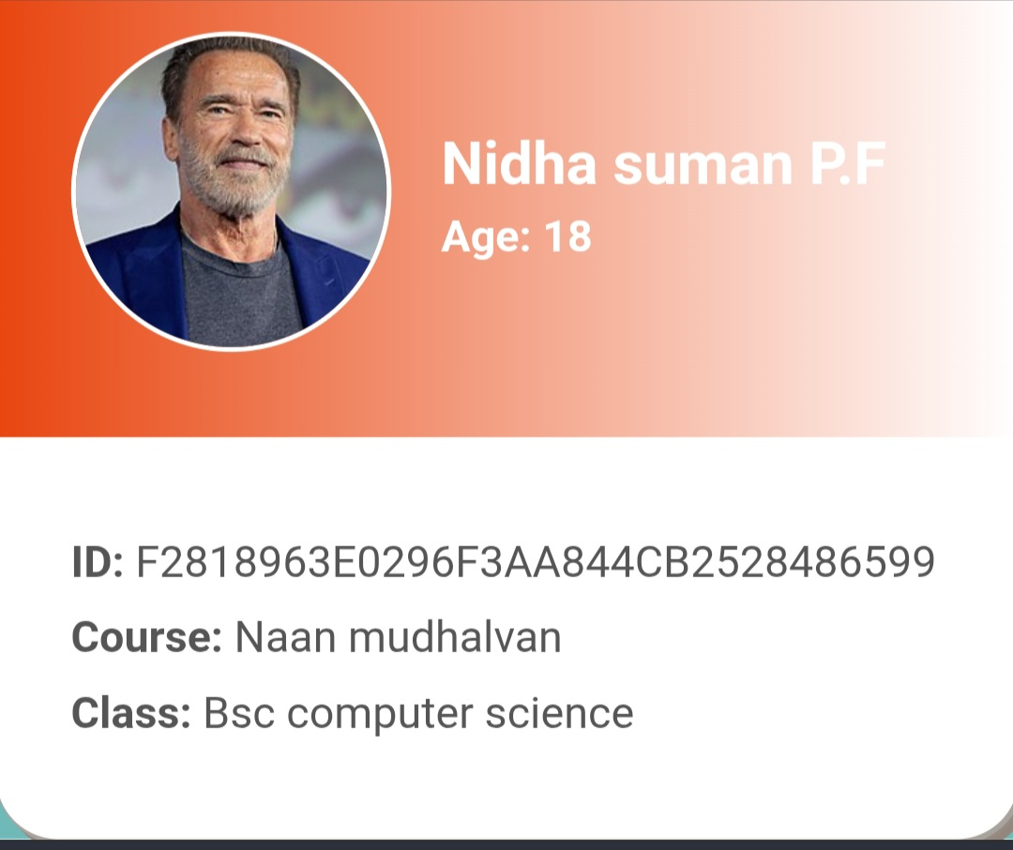
Student id
My id

Slide 22
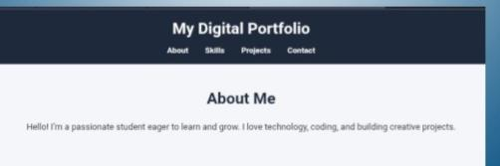
My PORTFOLIO profile

Slide 23
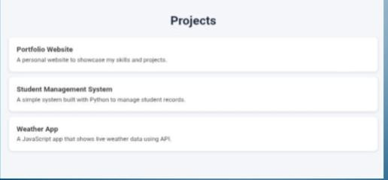
My project

Slide 24
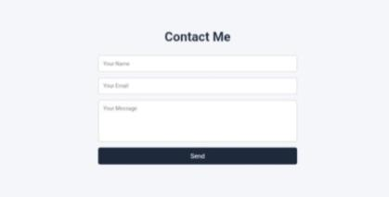
Contact

Slide 25
Conclusion
A digital portfolio conclusion should summarize the student's demonstrated skills and growth, highlighting their learning journey and readiness for future opportunities. It should emphasize the portfolio's role as more than a collection of work, but as a testament to their developing abilities and individual strengths, often serving as a powerful tool for college applications and career readiness by showcasing achievements, fostering self-reflection, and providing a competitive advantage.

Slide 26


